Slide 1
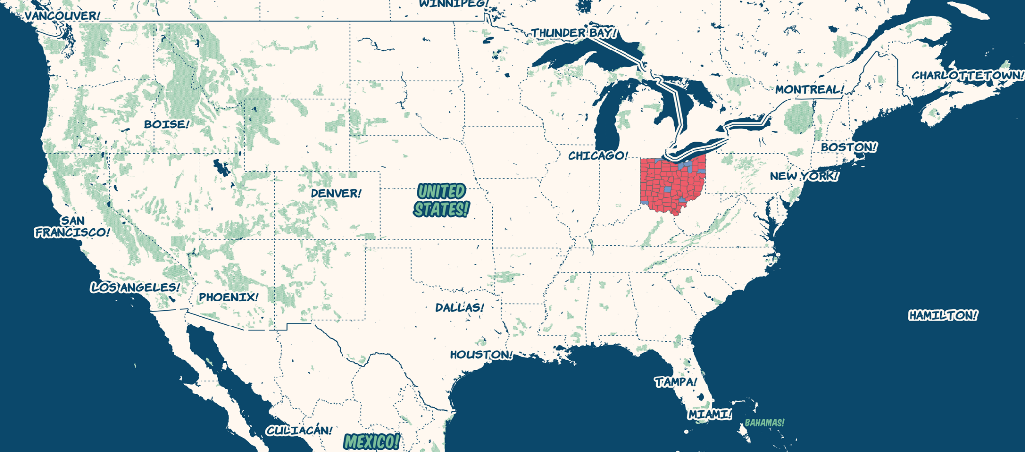
US Presidential Election Ohio 2016

Slide 2
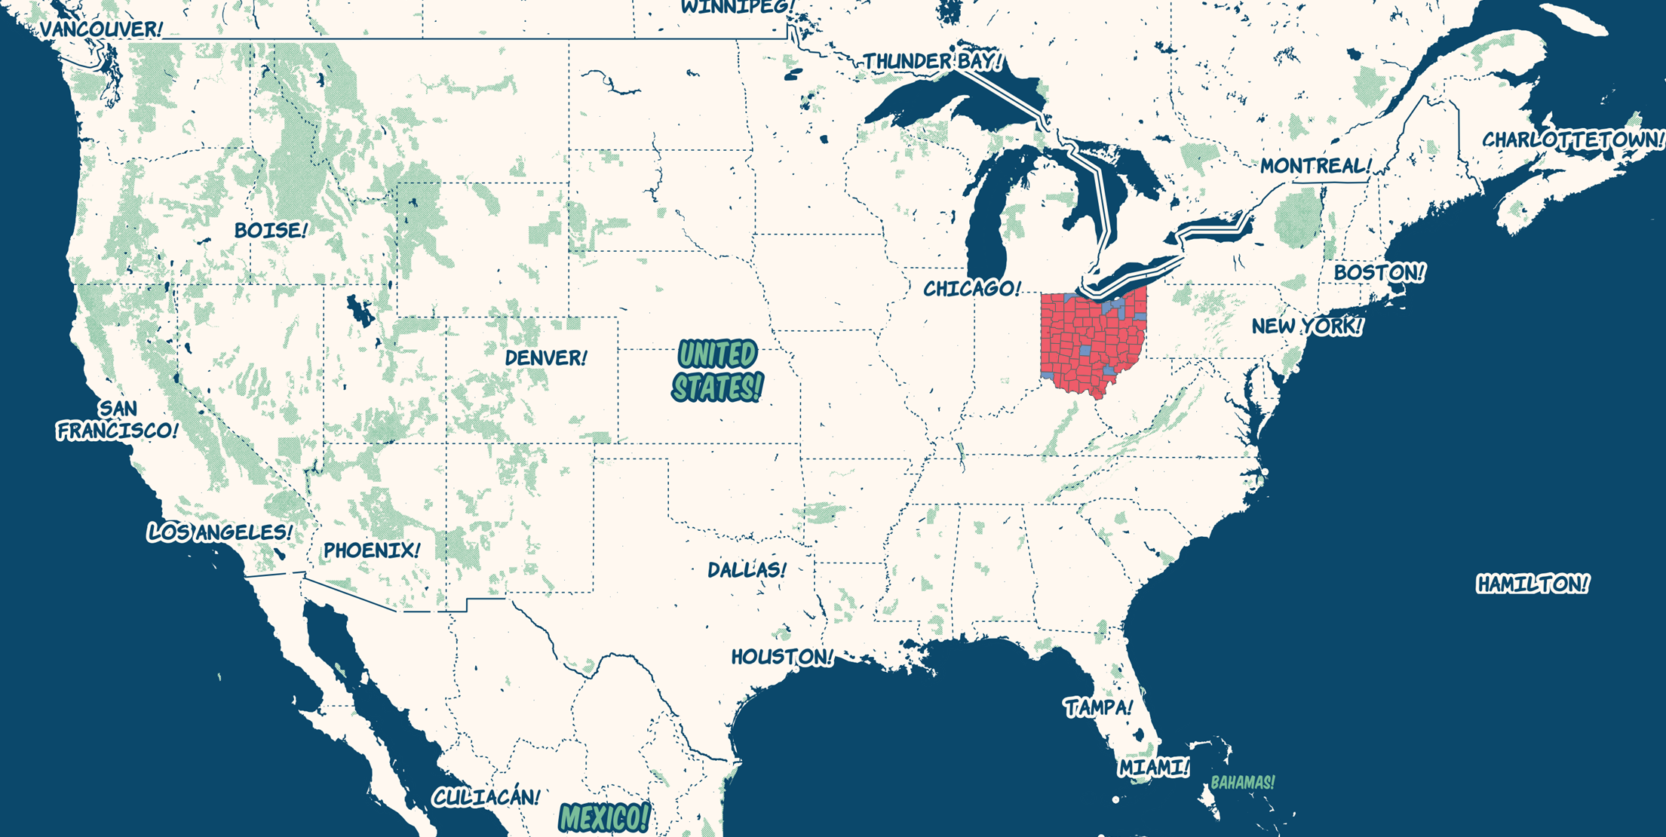

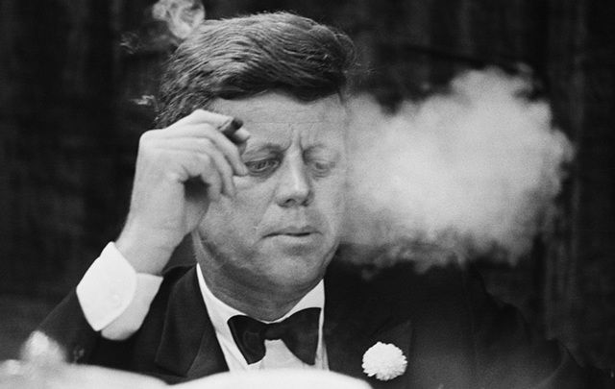
Why Ohio?

Slide 3
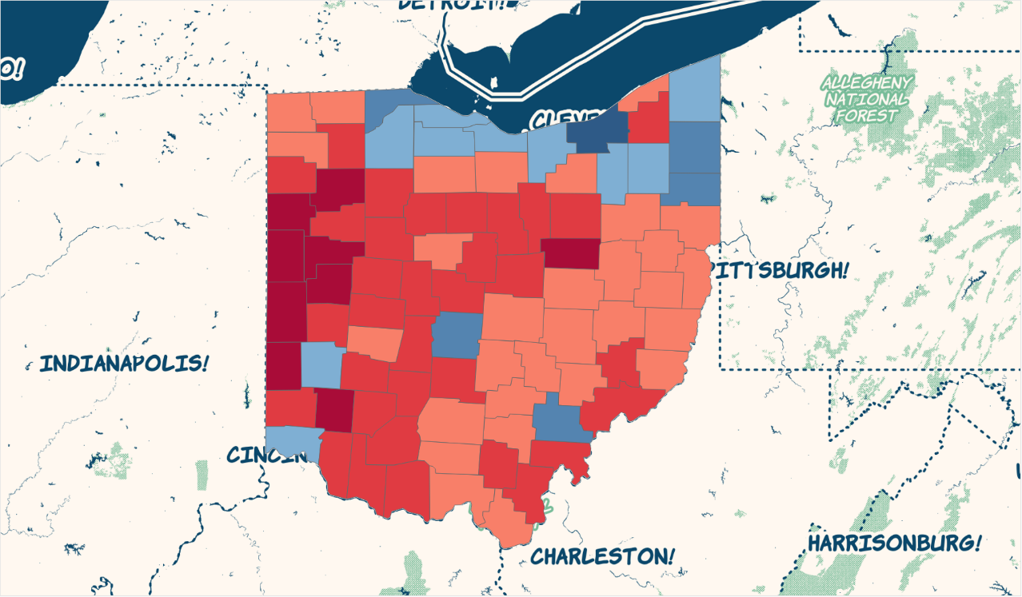
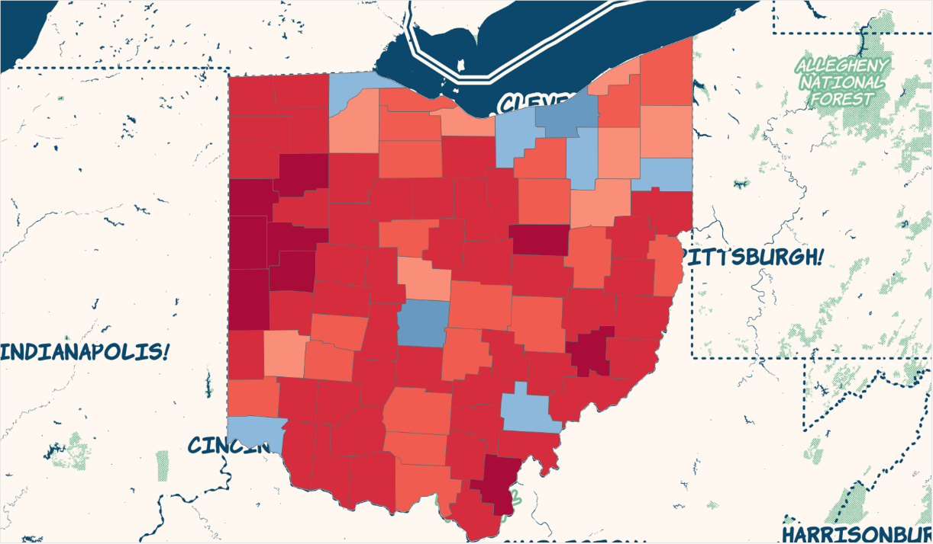
Ohio Electoral Map 2012 vs 2016
2016
2012

Slide 4
Ohio Electoral Map – Swing Counties

Slide 5
Ohio Electoral Map – Dem Density

Slide 6
Ohio Electoral Map – GOP Density

Slide 7
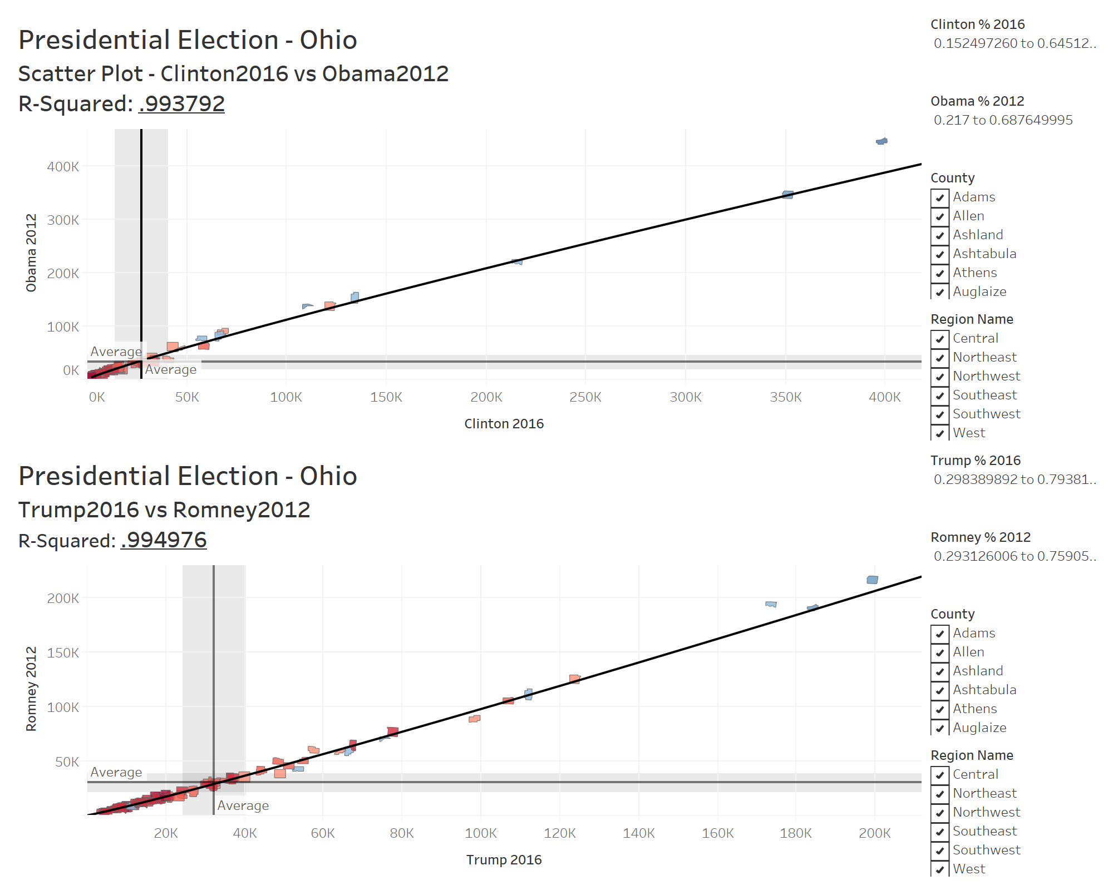
Ohio Electoral Map – Correlation

Slide 8
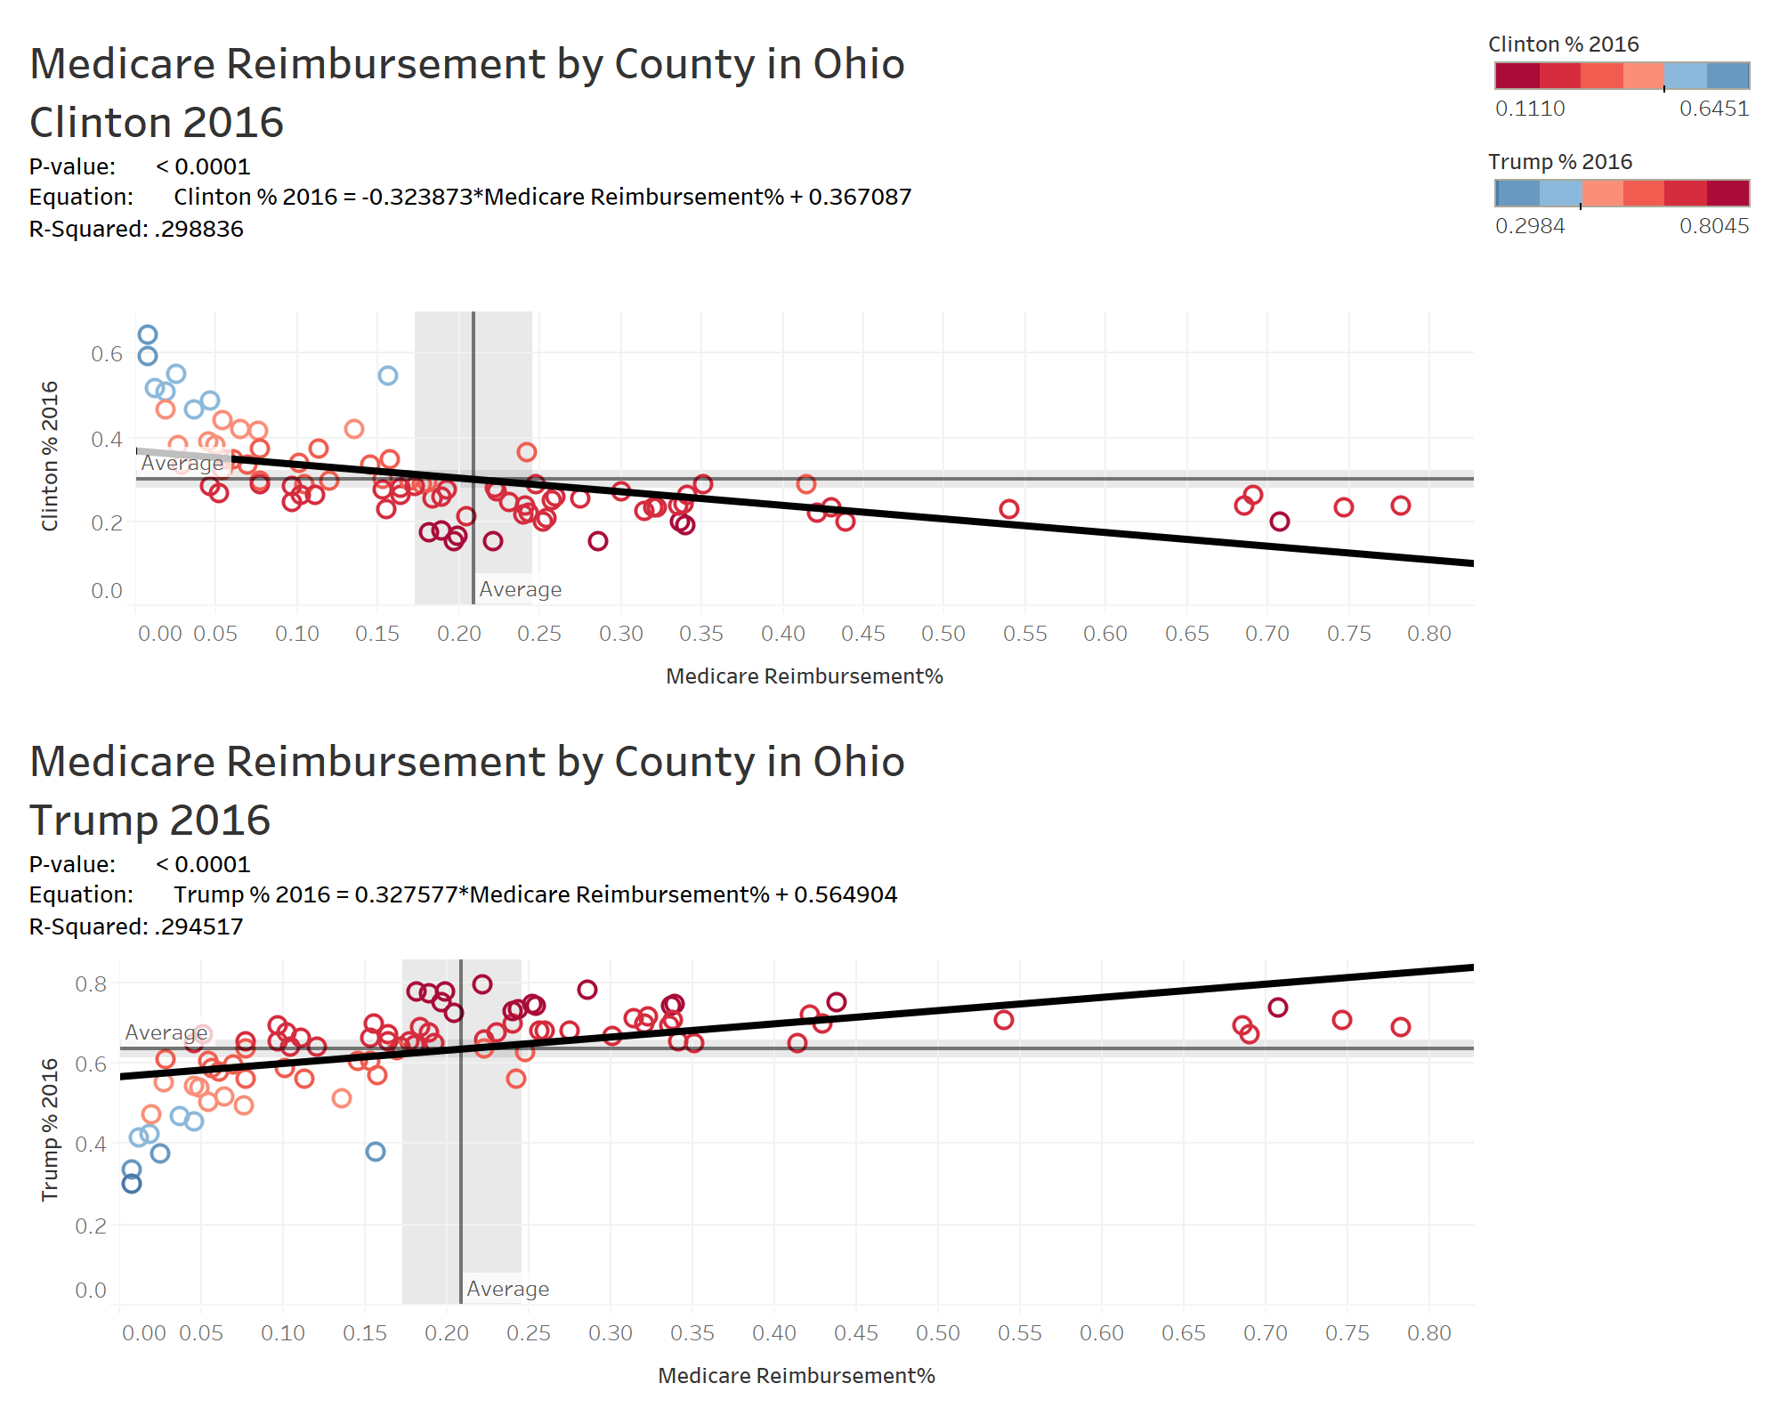
Medicare Reimbursement in Ohio by County, 2014

Slide 9
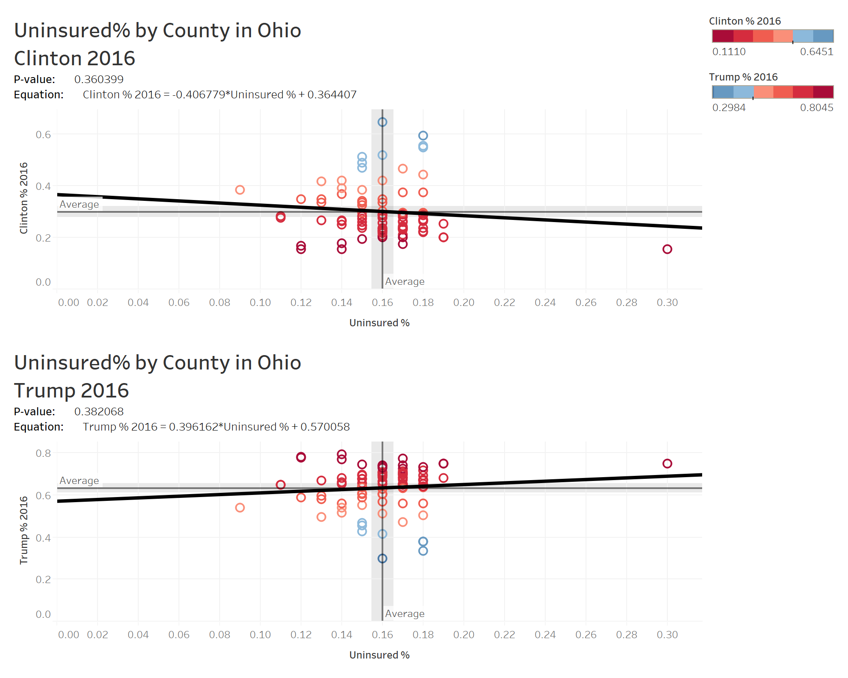
Uninsured Percentage in Ohio by County, 2016

Slide 10
Median Household Income in Ohio by County, 2016

Slide 11
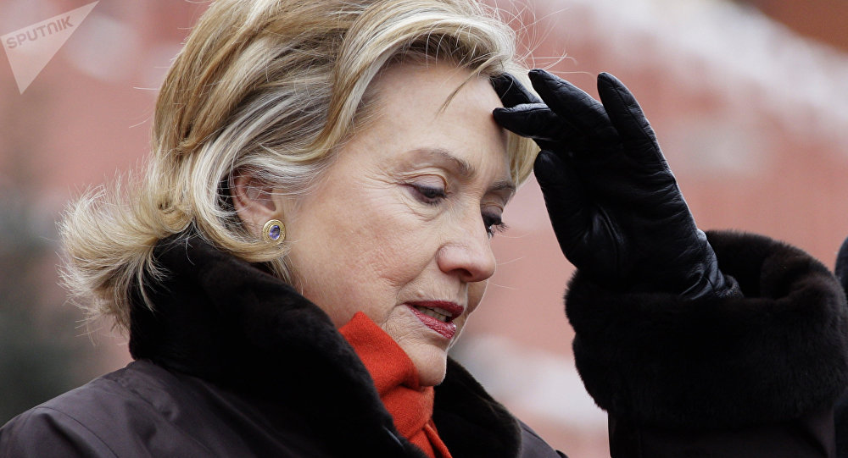



Cincinnati

Slide 12
Twitter 1

Slide 13
Twitter2

Slide 14
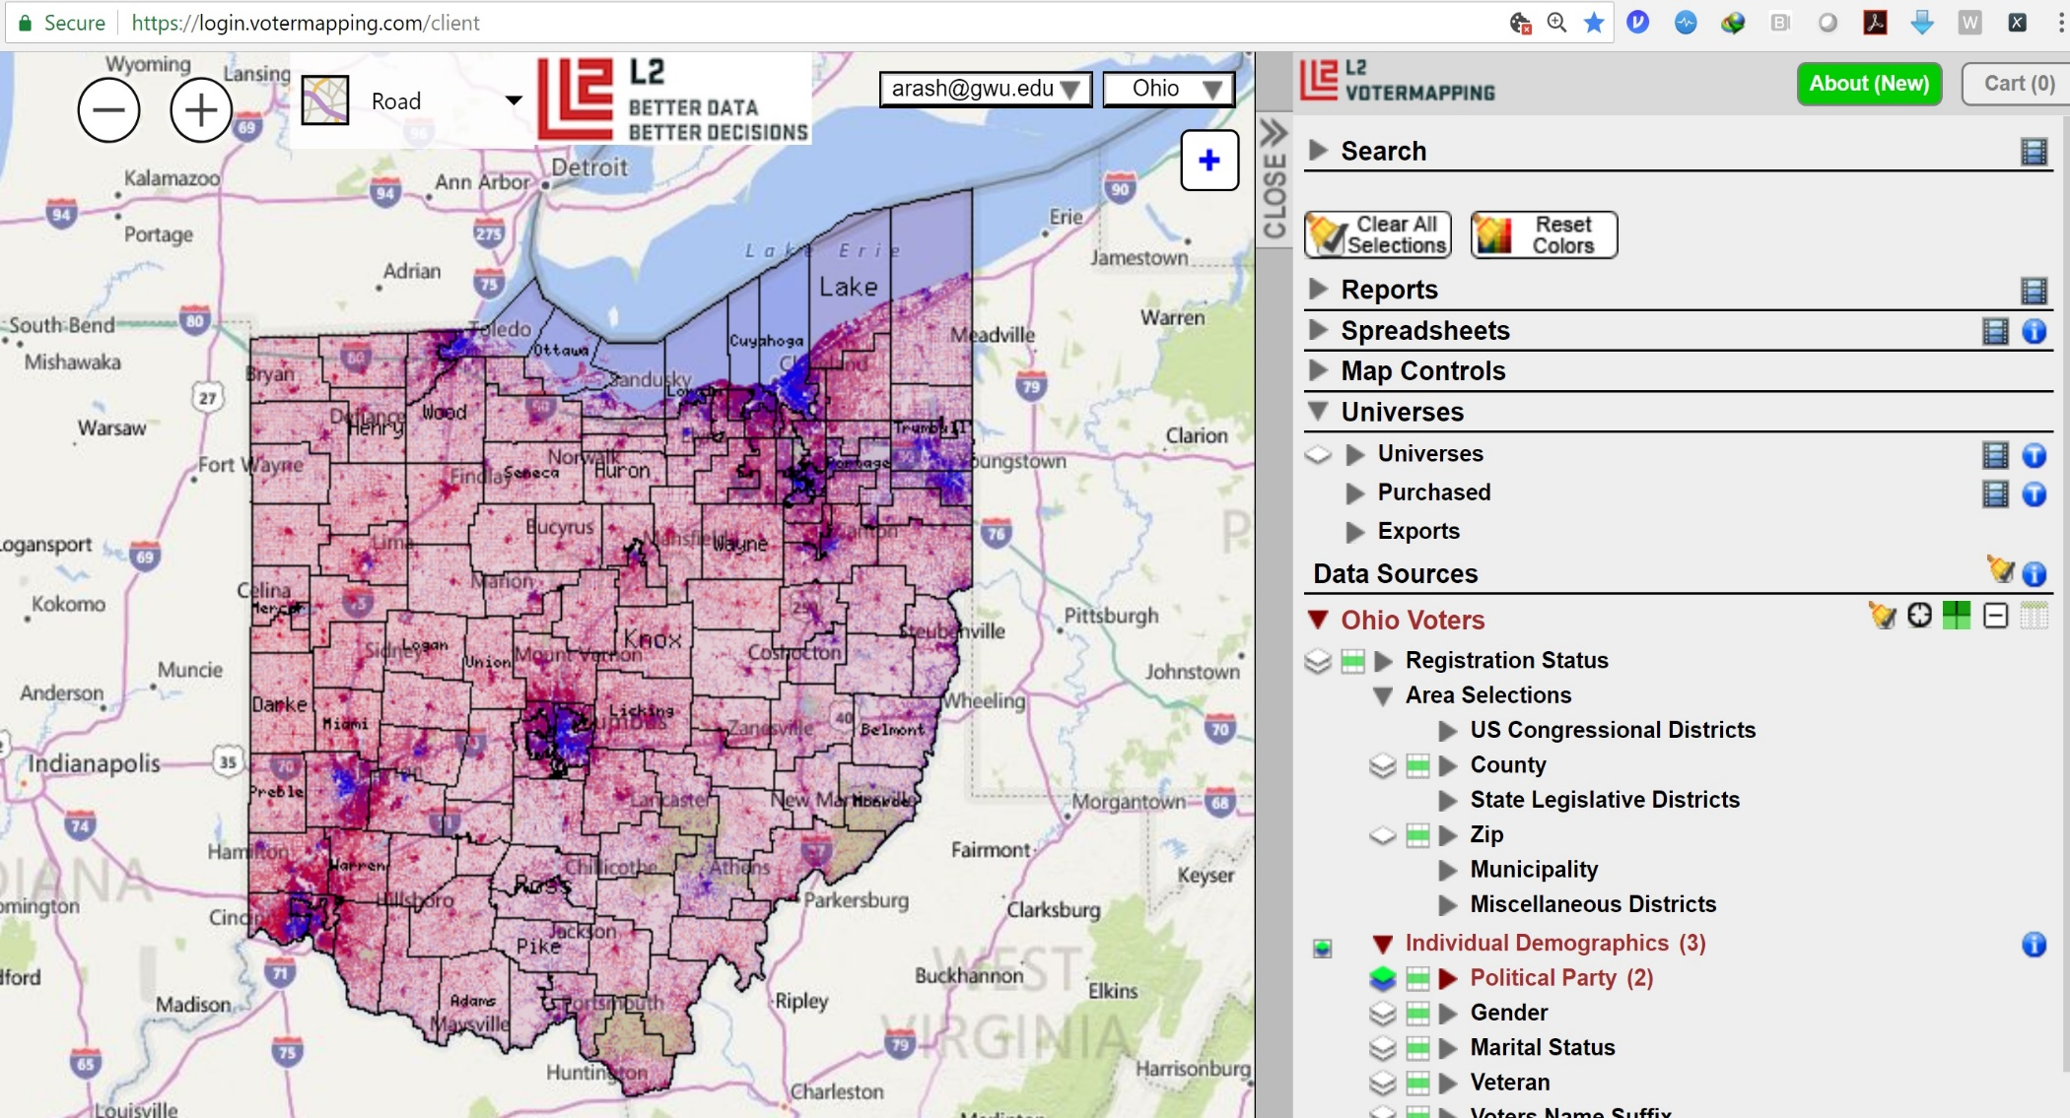
Ohio Electoral Map – L2 Voter File

Slide 15
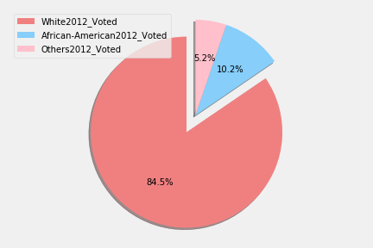
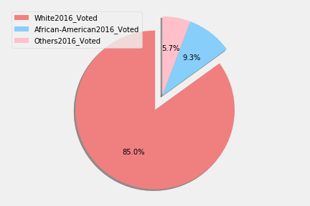
2012 vs 2016: Ethnicity_Voted
2016
2012

Slide 16
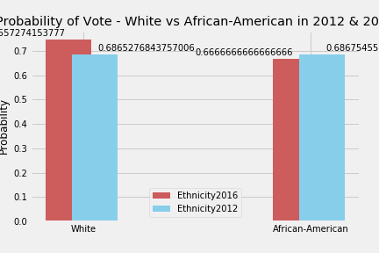
2012 vs 2016: Ethnicity_P(Vote)

Slide 17
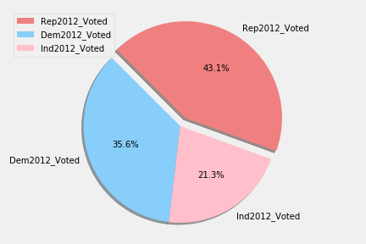
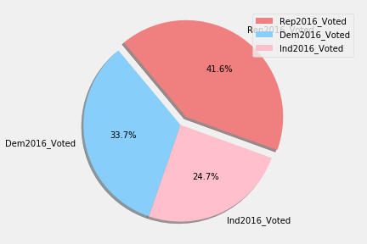
2012 vs 2016: Party-Affiliation_Voted
2016
2012

Slide 18
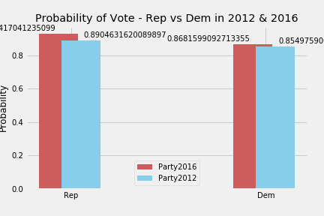
2012 vs 2016: Party-Affiliation_P(Vote)

Slide 19
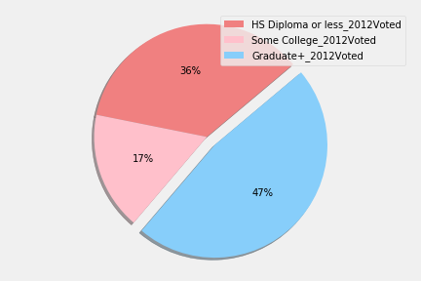
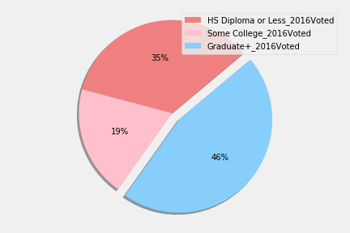
2012 vs 2016: Education_Voted
2016
2012

Slide 20
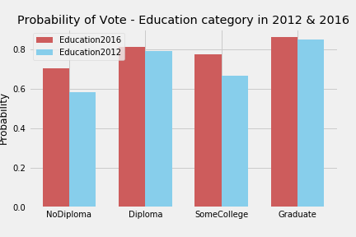
2012 vs 2016: Education_P(Vote)

Slide 21
THANK YOU
ohIO is OHio,
http://github.com/arashghafouri
https://github.com/tpinon007
https://github.com/harriskl1
https://github.com/mplusc

